Slide 1
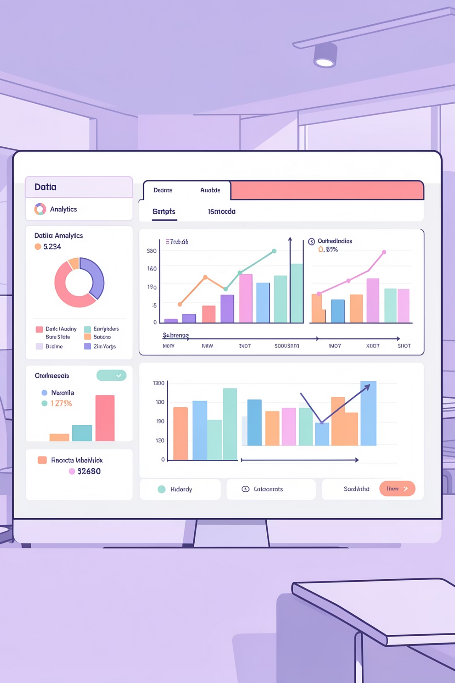
Customer Shopping Behavior Analysis
Uncovering insights from 3,900 purchases to guide strategic decisions

Slide 2
DATASET OVERVIEW
The Foundation
3.9K
18
4
Total Purchases
Data Points
Categories
Transactions analyzed
Features per customer
Product types tracked
Key Features Captured
Customer demographics: Age, Gender, Location
Purchase details: Category, Amount, Season, Size, Color
Behavior metrics: Discounts, Reviews, Frequency, Shipping
Subscription status tracking

Slide 3
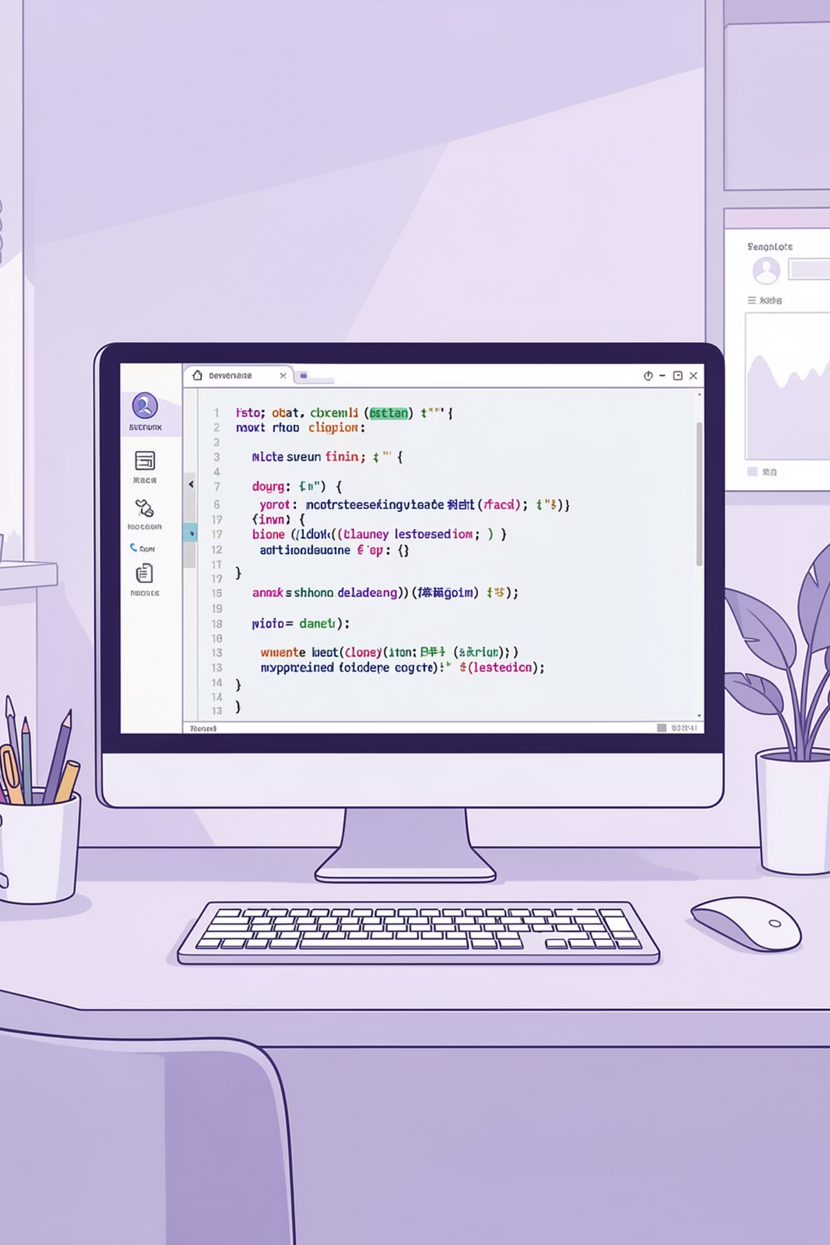
PHASE 1
Data Preparation in Python
01
Data Loading & Exploration
Imported dataset, checked structure with df.info() and summary statistics
02
Cleaning & Standardization
Imputed 37 missing Review Ratings, renamed columns to snake_case
03
Feature Engineering
Created age_group bins and purchase_frequency_days metrics
04
Database Integration
Connected to PostgreSQL and loaded cleaned data for SQL analysis

Slide 4

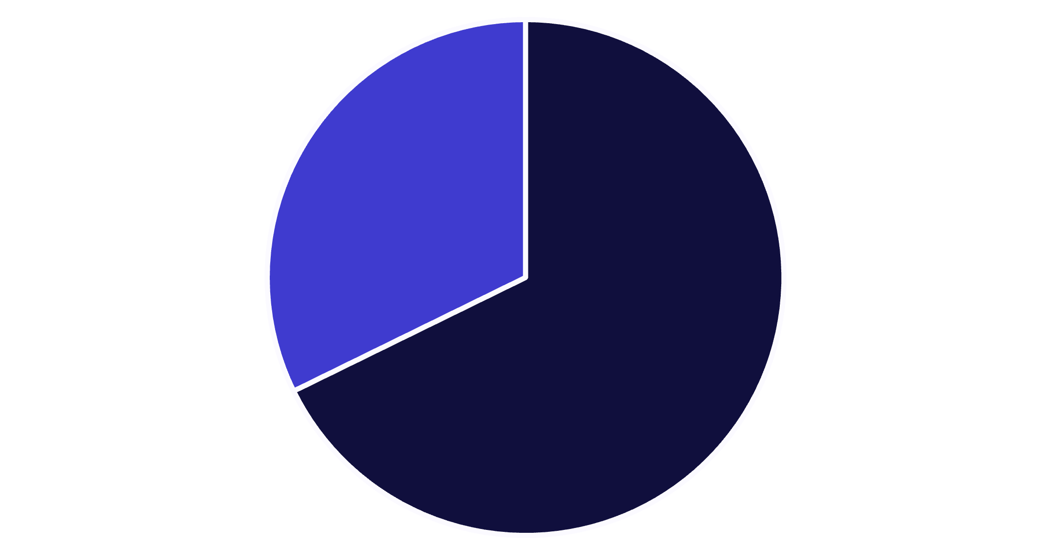
SQL ANALYSIS
Revenue Insights by Gender
Male Customers Drive Revenue
Male shoppers generate 68% of total revenue despite representing 68% of customer base.
Total revenue analyzed: $233,081
Male
Female

Slide 5
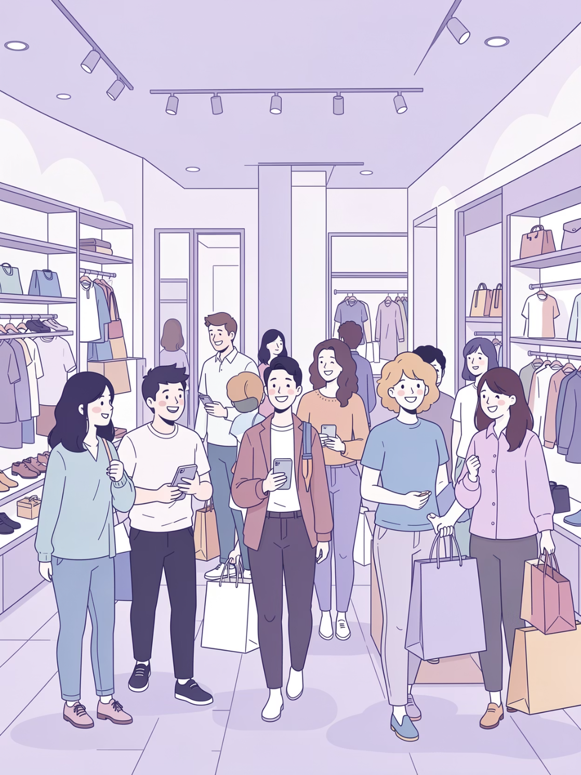
Customer Segmentation Analysis
Loyal Customers
Returning
New
701 customers
83 customers
3,116 customers
18% showing repeat behavior
2% first-time buyers
80% of customer base
Strong loyalty foundation with opportunity to convert returning customers

Slide 6
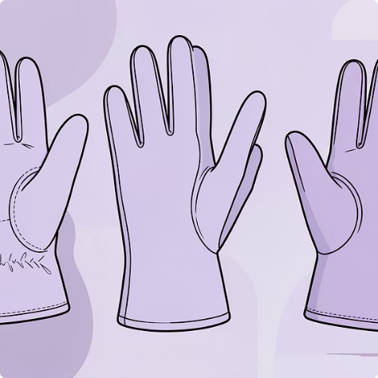
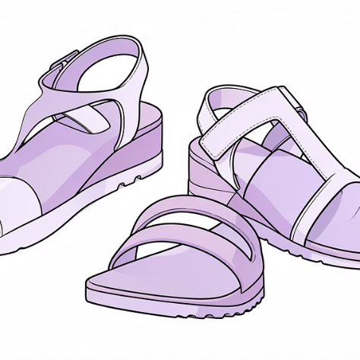
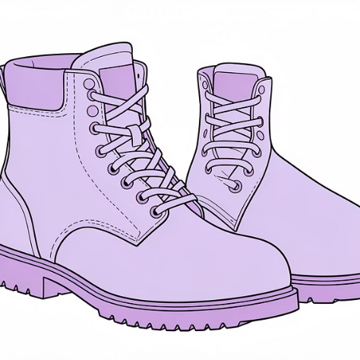

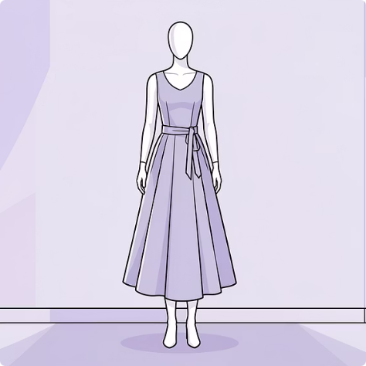
Top-Rated Products
Gloves
Sandals
Boots
Hat
⭐ 3.86 rating
⭐ 3.84 rating
⭐ 3.82 rating
⭐ 3.80 rating
Skirt
⭐ 3.78 rating

Slide 7
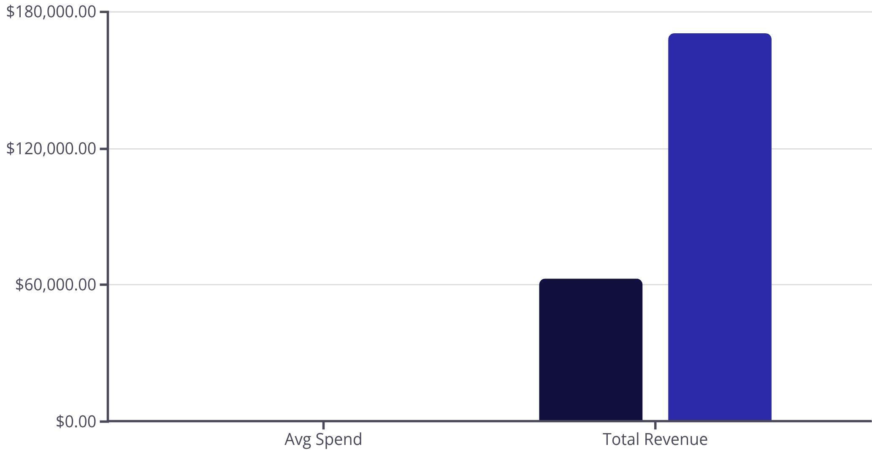
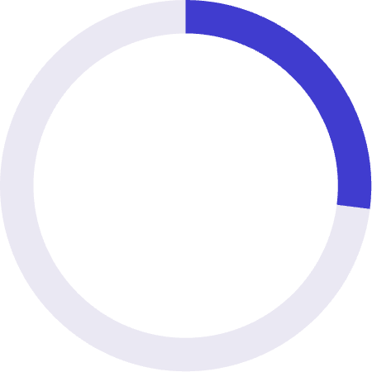
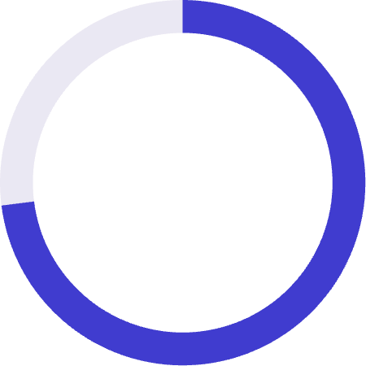
SUBSCRIPTION COMPARISON
Subscribers vs. Non-Subscribers
Subscribers
Non-Subscribers
Key Findings
27%
73%
Subscribers
Non-subscribers
Similar spending patterns but massive untapped subscription potential

Slide 8
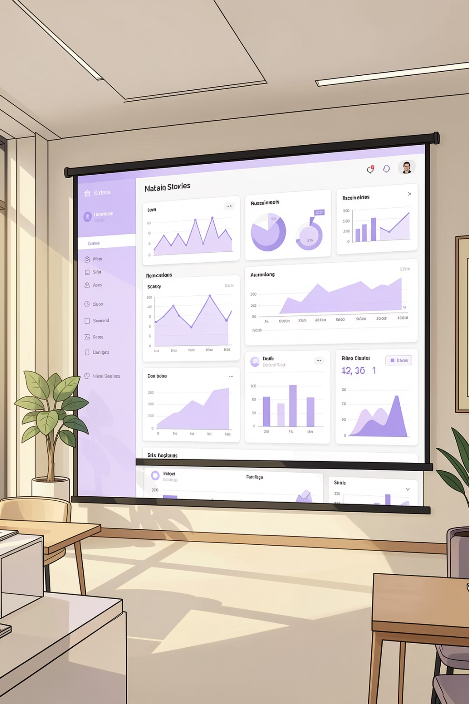

POWER BI
Interactive Dashboard Highlights
Revenue by Category
Age Group Performance
Key Metrics
Avg purchase: $59.76 | Avg rating: 3.75 stars
Clothing leads at $100K, followed by Accessories at $70K
Young Adults generate highest revenue at $62K

Slide 9



STRATEGIC RECOMMENDATIONS
Action Plan for Growth
Boost Subscriptions
Loyalty Programs
Targeted Marketing
Promote exclusive benefits to convert 73% non-subscribers
Reward repeat buyers to grow loyal segment
Focus on high-revenue age groups and express shipping users

Slide 10

Next Steps
Review Discount Policy
Product Positioning
Highlight top-rated items (Gloves, Sandals, Boots) in campaigns
Balance sales boosts with margin control—839 high spenders used discounts
Monitor & Iterate
Track dashboard metrics and refine strategies quarterly

